Slide 1
Unsupervised Learning
Tuesday, Lecture 2
FASE ML Bootcamp
Based on material from:
Elements of Statistical Learning by Hastie, Tibshirani, Friedman,
Nina Balca, CMU 10-601
Google’s ML course
Elena Sügis’ slides
Derek Hoeim’s slides

Slide 2
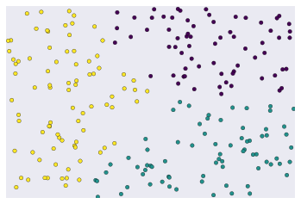
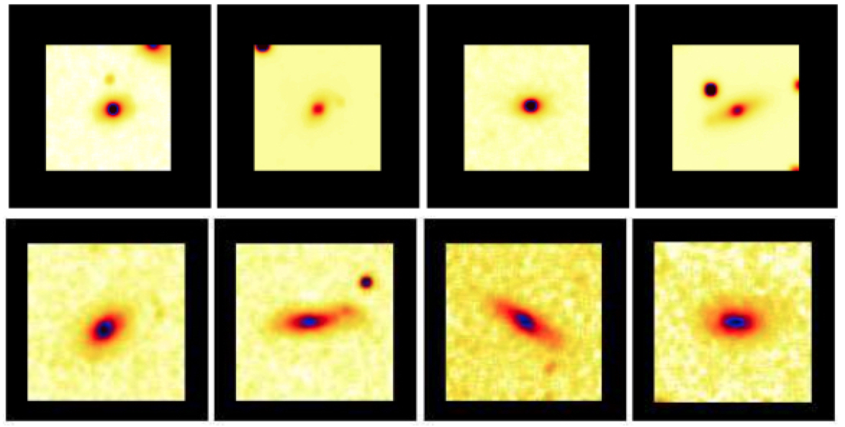
Clustering
https://developers.google.com/machine-learning/clustering/overview
The most common type of unsupervised learning
Goal: group “similar” data points together
Unsupervised because we don’t label the data as we did in classification/regression: let the features speak for themselves!
Clustering galaxies, from Miller et al. (2005)

Slide 3
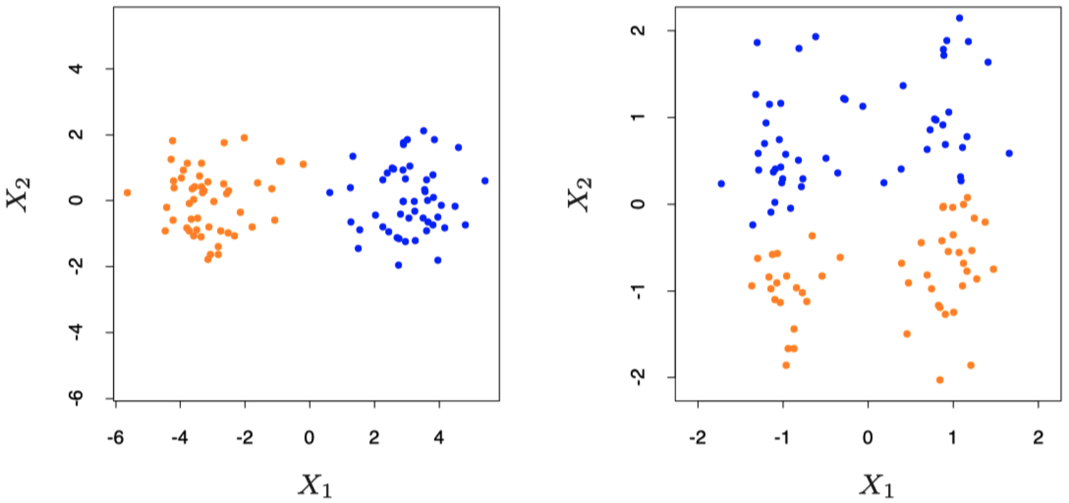
Data Preparation for Clustering
The points are colored by a clustering algorithm
Raw data
Standardized data

Slide 4
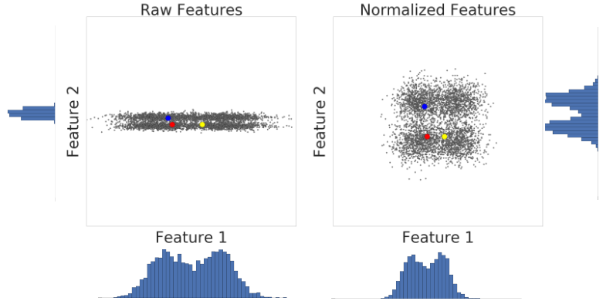
Data Preparation for Clustering
https://developers.google.com/machine-learning/clustering/prepare-data

Slide 5
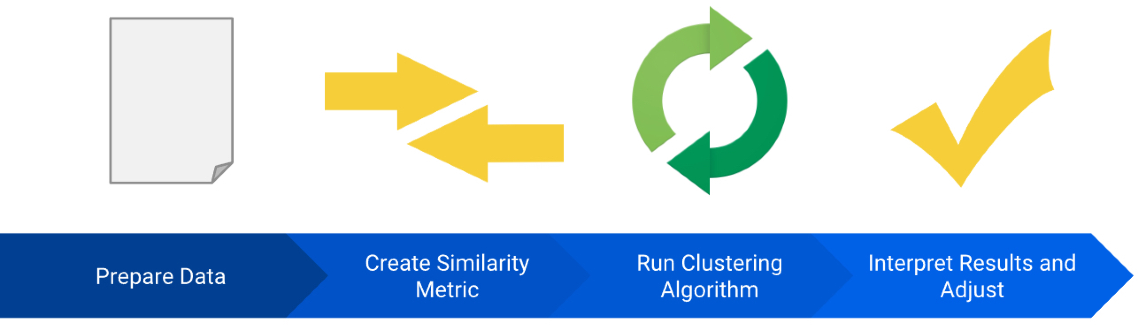
Clustering workflow
From Google’s Clustering lesson: https://developers.google.com/machine-learning/clustering/

Slide 6
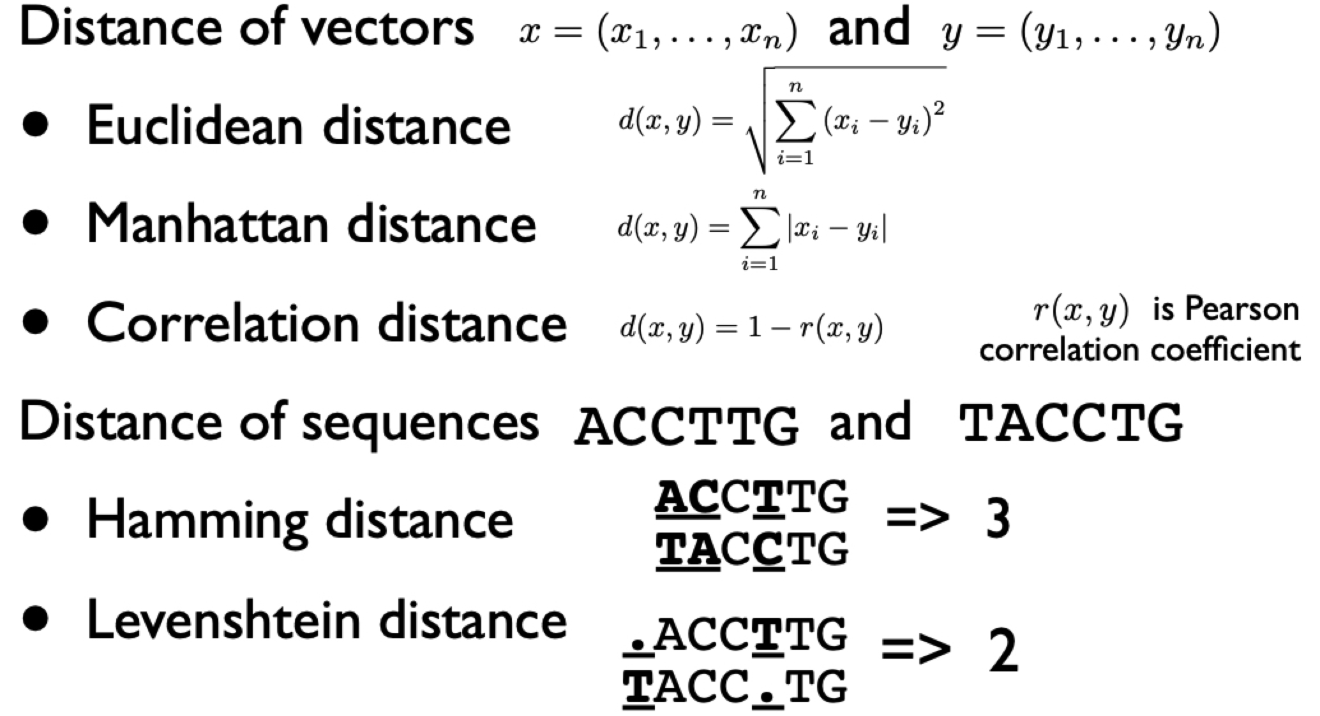
Distance Metrics
The right distance metric depends on your application!
Based on slides by Elena Sügis: http://bioinformaticsinstitute.ru/sites/default/files/preprocessing_unsupervised.pdf

Slide 7
Clustering workflow
From Google’s Clustering lesson: https://developers.google.com/machine-learning/clustering/

Slide 8
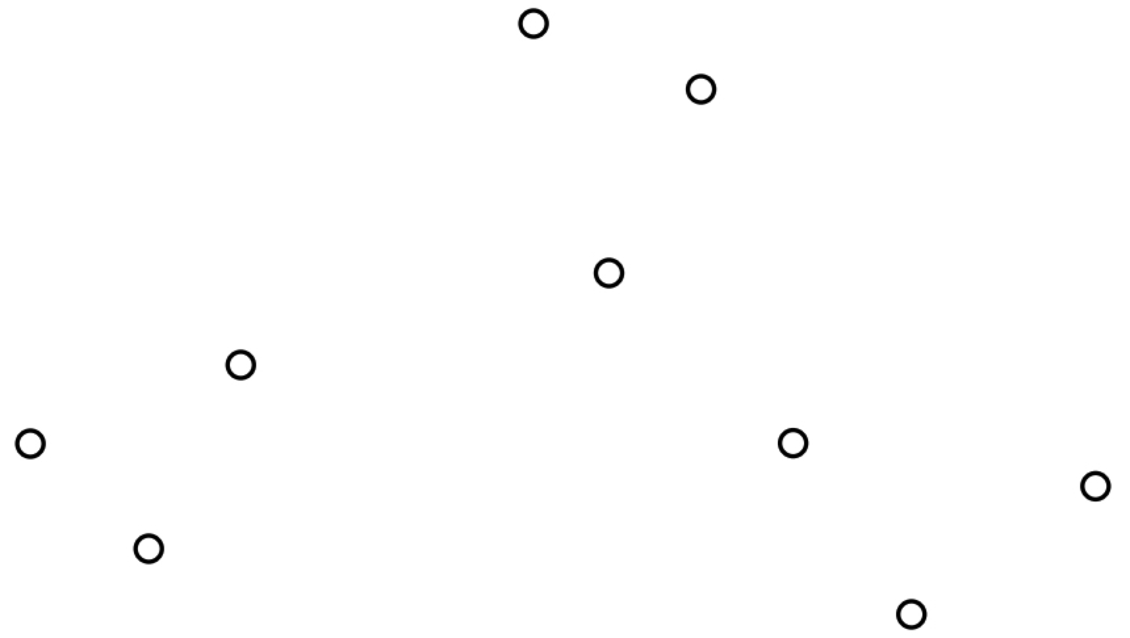
K-means Clustering
Euclidean distance metric
Given a set of data points…

Slide 9
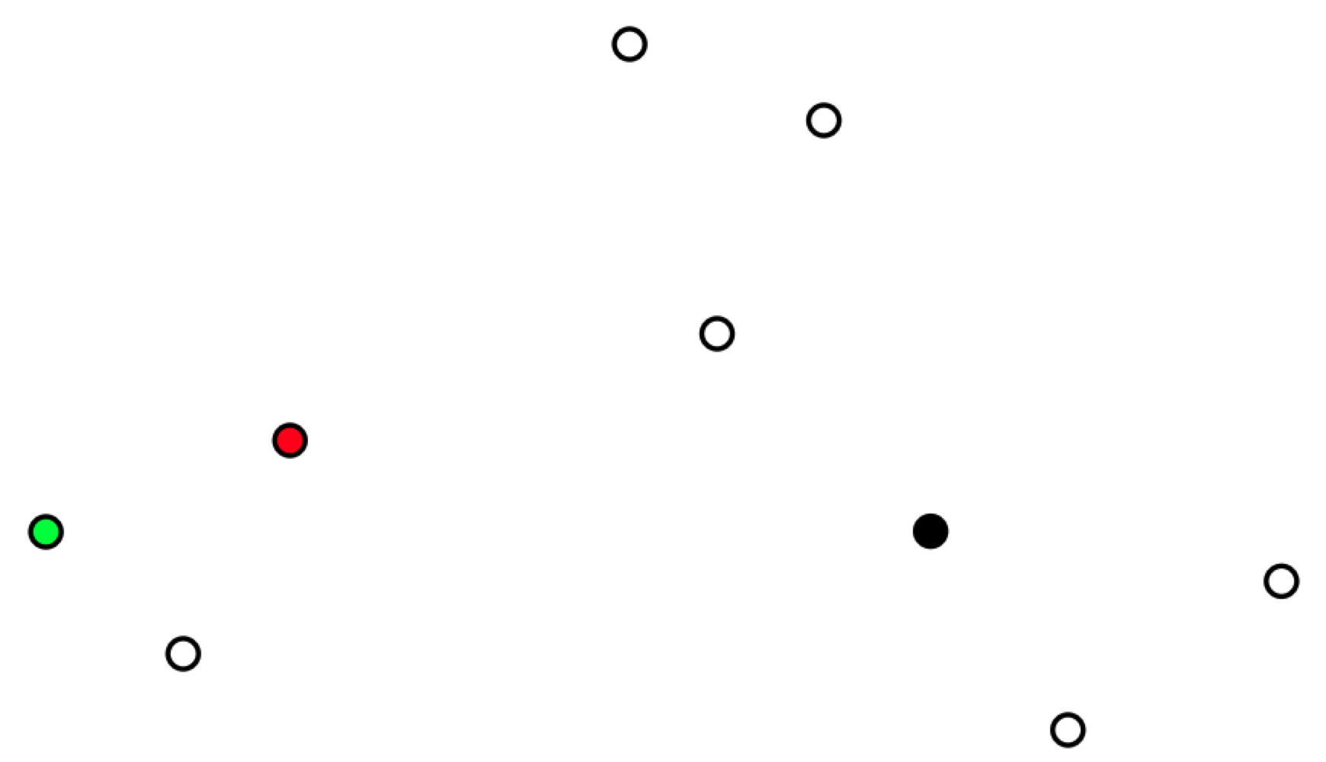
K-means Clustering
Euclidean distance metric
Select k=3 initial centers at random

Slide 10
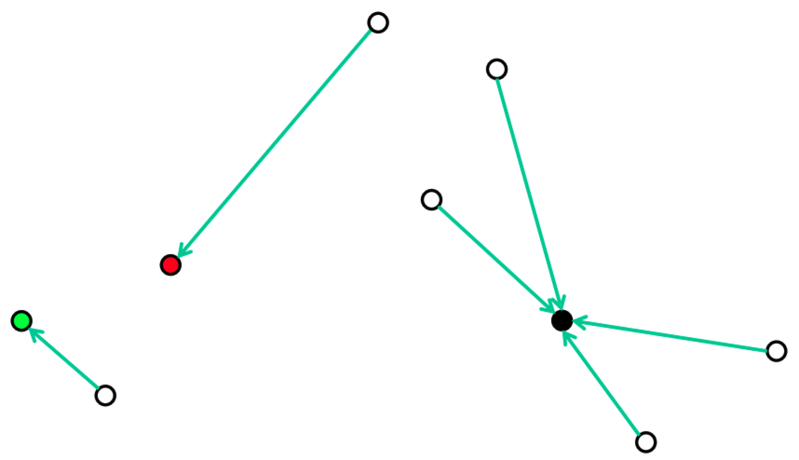
K-means Clustering
Euclidean distance metric
Recompute optimal centers given a fixed clustering

Slide 11
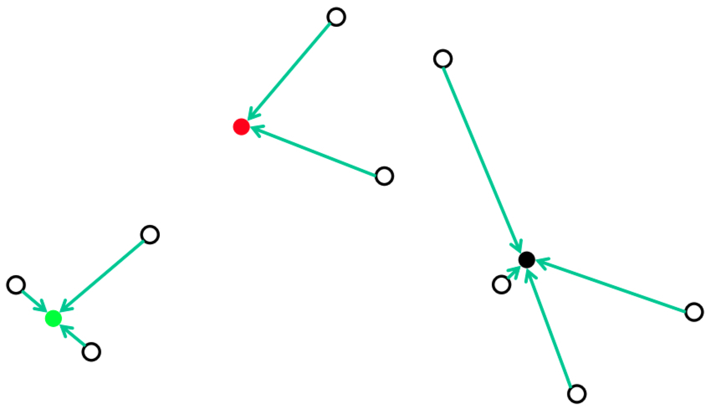
K-means Clustering
Euclidean distance metric
Assign each point to its nearest center

Slide 12
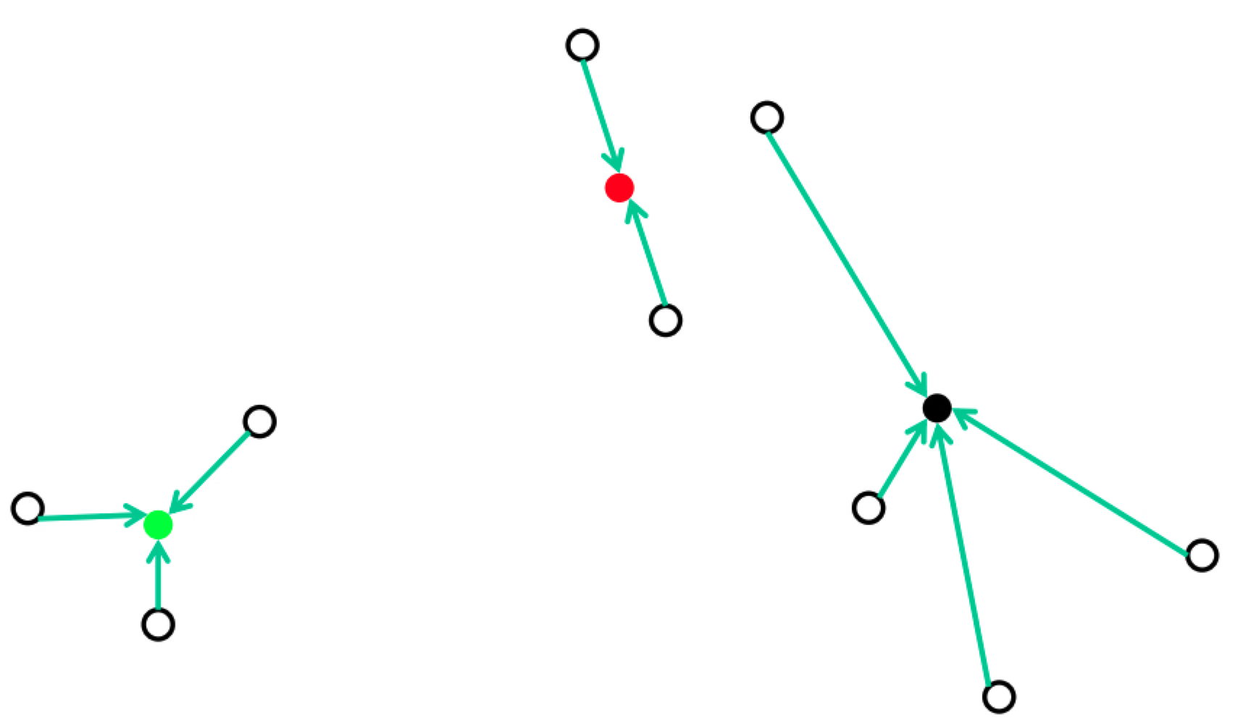
K-means Clustering
Euclidean distance metric
Recompute optimal centers given a fixed clustering

Slide 13
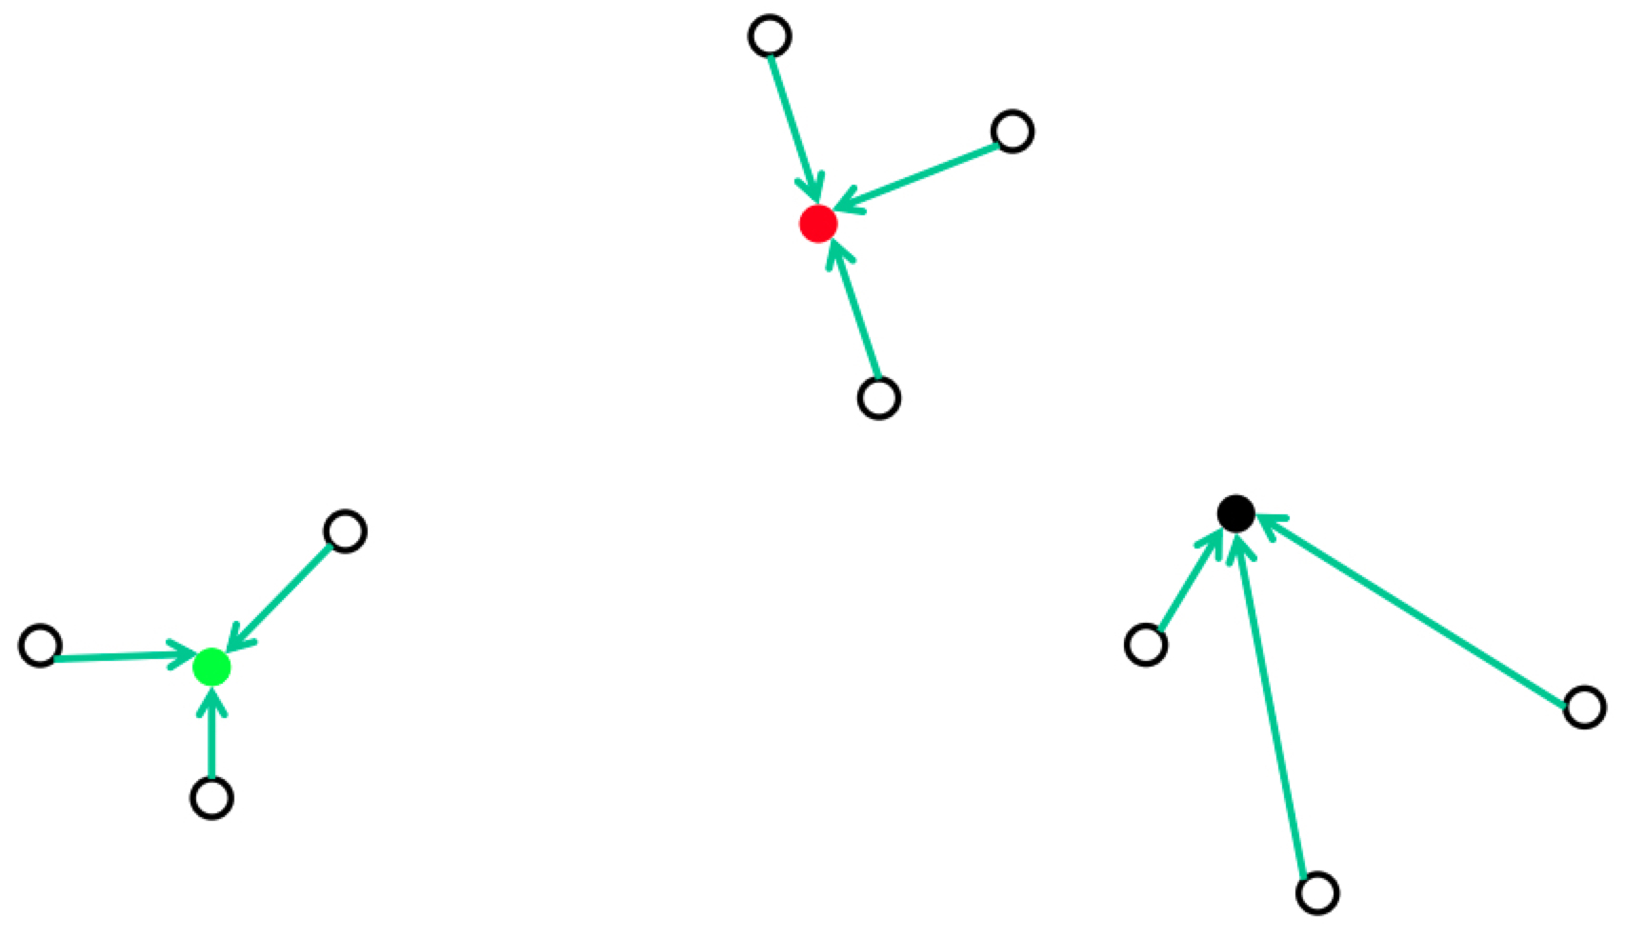
K-means Clustering
Euclidean distance metric
Assign each point to its nearest center

Slide 14
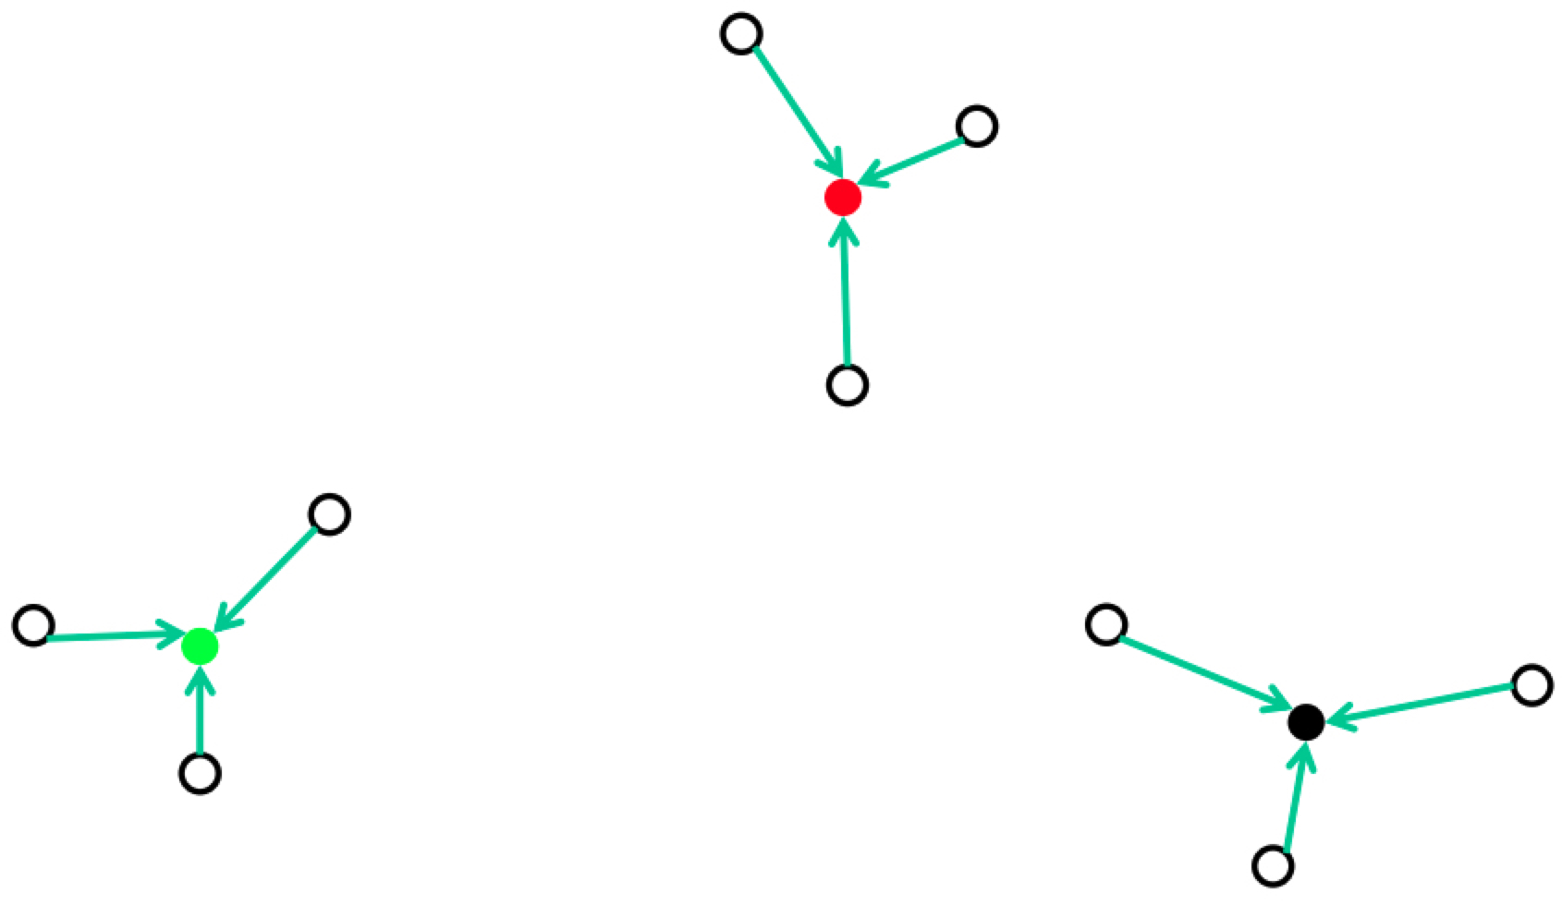
K-means Clustering
Euclidean distance metric
Recompute optimal centers given a fixed clustering

Slide 15
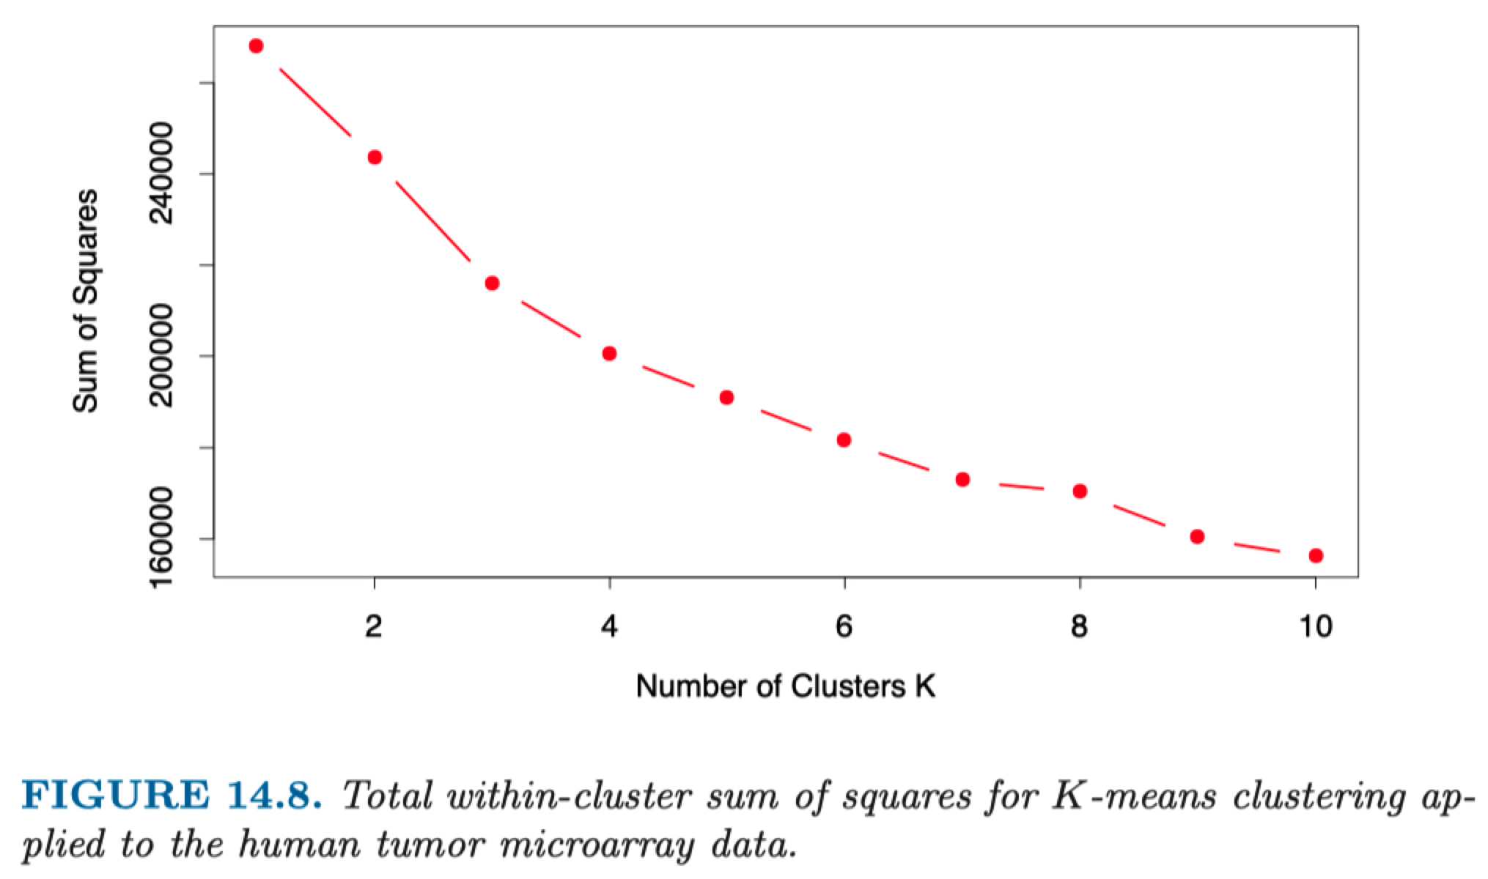
Selecting the number of clusters

Slide 16
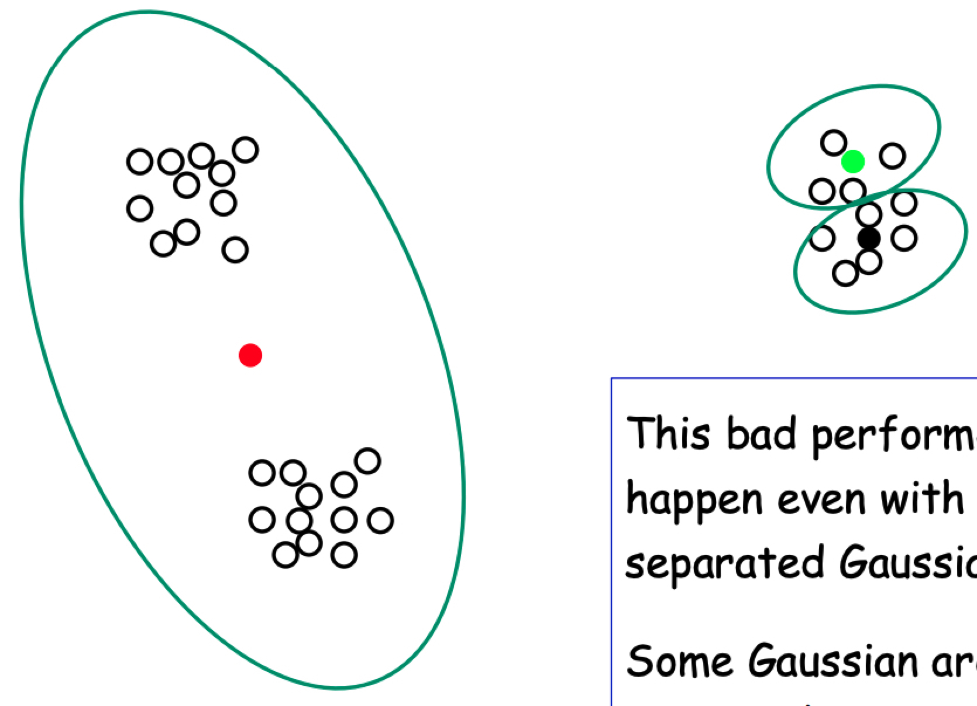
K-means can fail
This is a heuristic!
No guarantees it’ll find optimum
In practice, smarter centroid initialization solves this

Slide 17
Clustering workflow
From Google’s Clustering lesson: https://developers.google.com/machine-learning/clustering/

Slide 18
From Google’s Clustering lesson: https://developers.google.com/machine-learning/clustering/

Slide 19
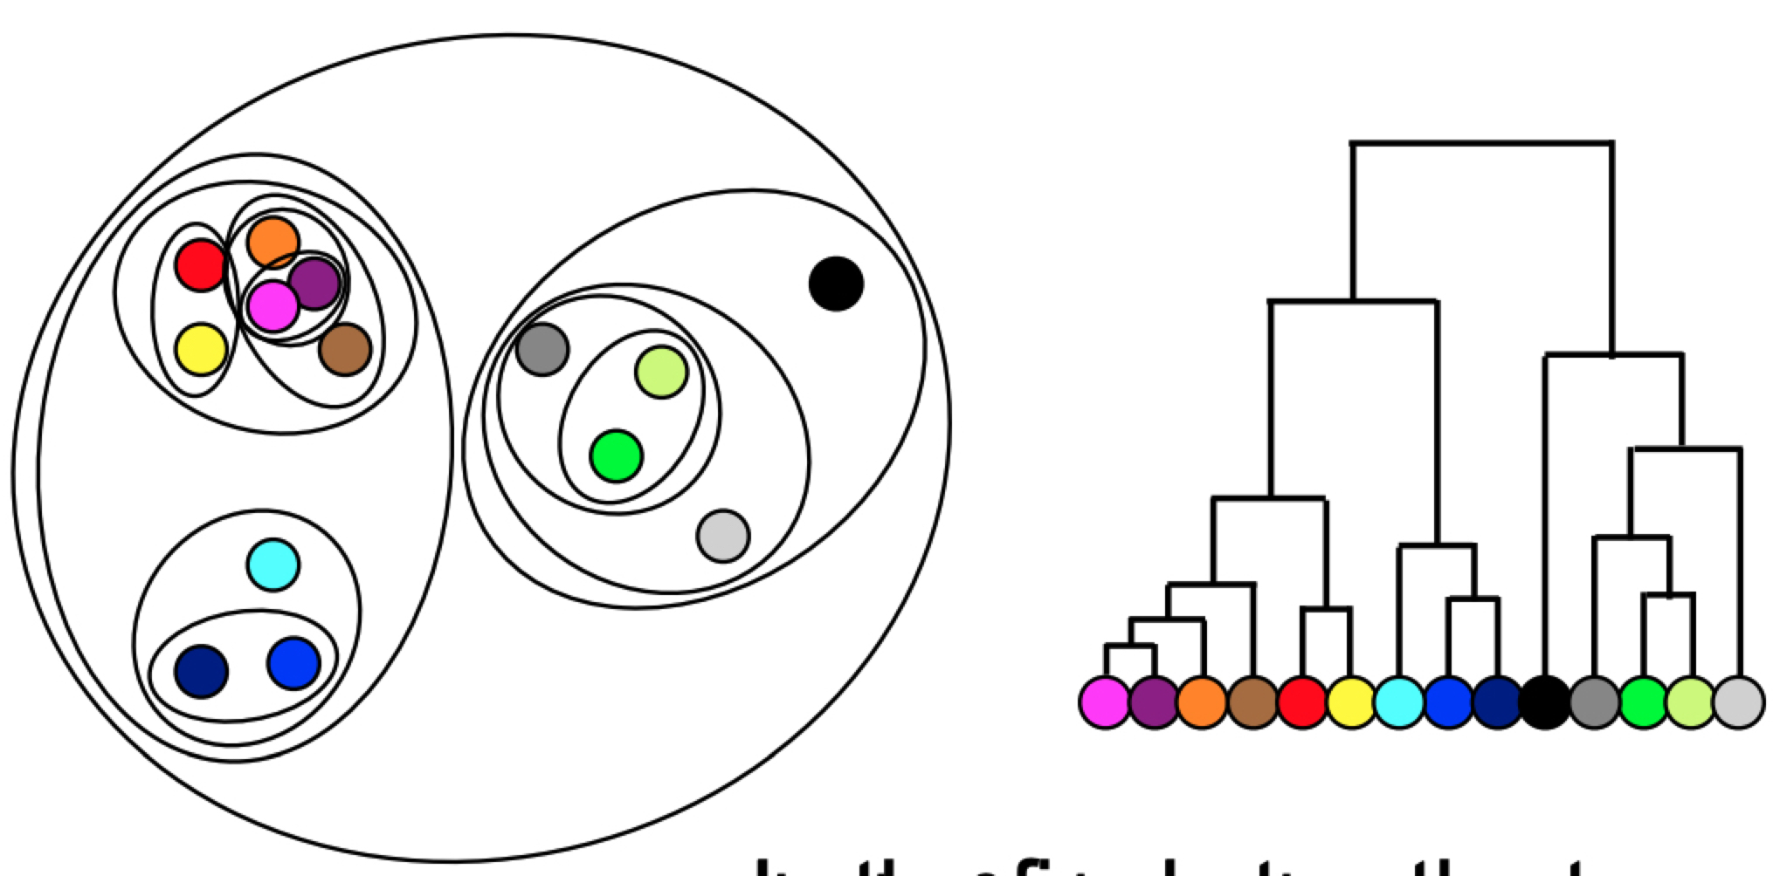
Hierarchical Clustering
High-level idea: build a tree (hierarchy) of clusters
Based on slides by Elena Sügis: http://bioinformaticsinstitute.ru/sites/default/files/preprocessing_unsupervised.pdf

Slide 20
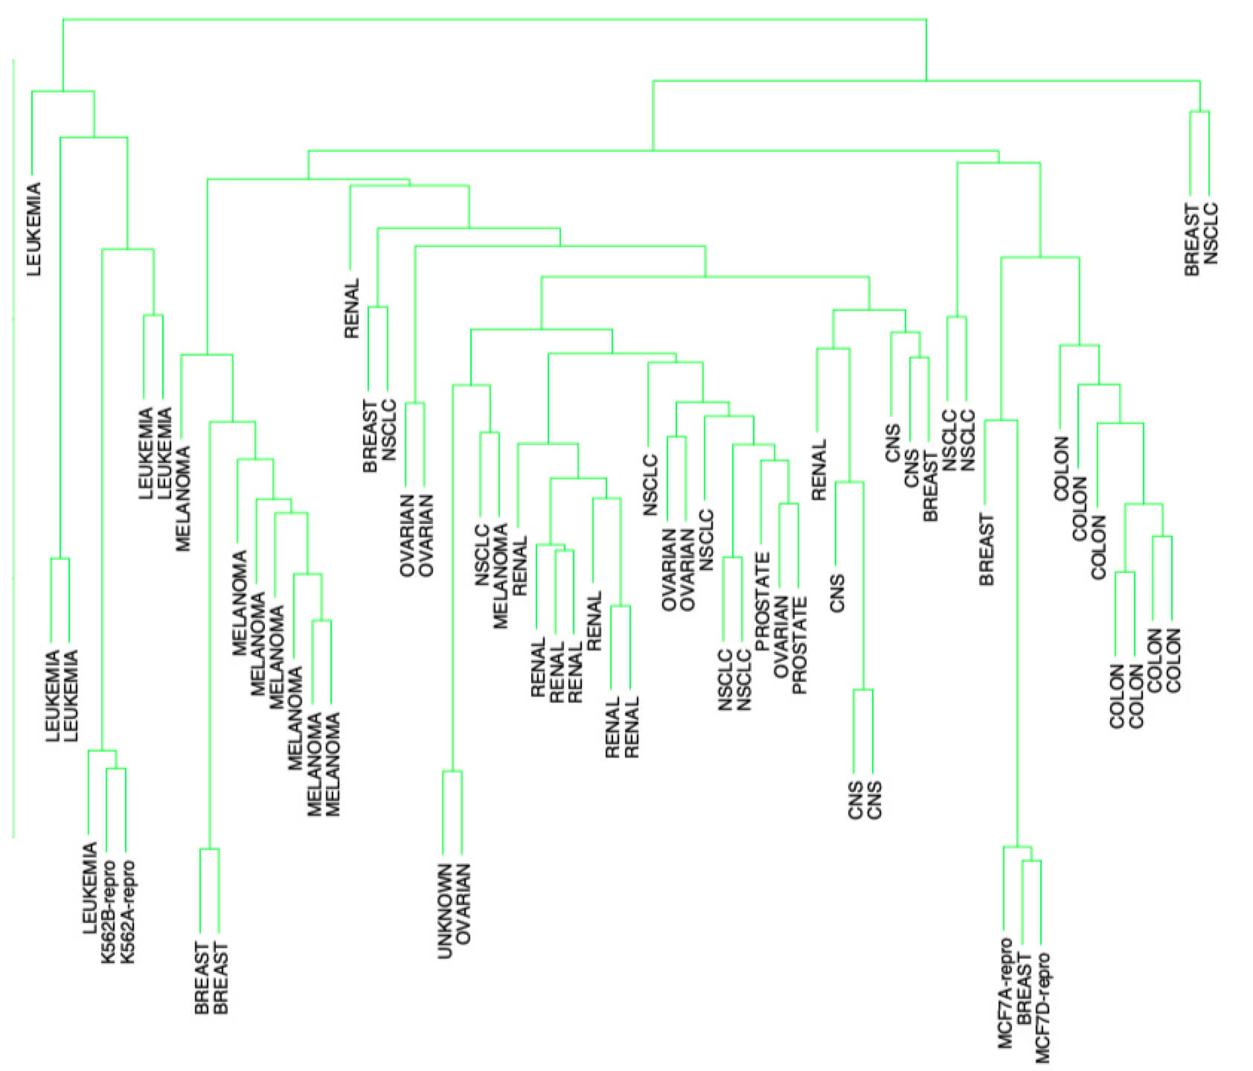
Hierarchical Clustering
Human Tumor Microarray Data
64 samples, 6830 features (gene expression levels)
Elements of Statistical Learning,
Chapter 14.3.8

Slide 21
Dimensionality Reduction
or dealing with very high-dimensional data

Slide 22
Dimensionality Reduction
Examples: Principal Component Analysis (PCA), t-SNE, …
Powerful unsupervised learning techniques for extracting hidden (potentially lower dimensional) structure from high dimensional datasets.
Useful for:
Visualization
Data compression for faster supervised learning
Noise removal
Based on slide by Nina Balcan

Slide 23
Principal Component Analysis (PCA)
Principal Components (PC) are orthogonal directions that capture most of the variance in the data.
PC 1
PC 2

Slide 24

Principal Component Analysis (PCA)
From https://stats.stackexchange.com/a/140579

Slide 25
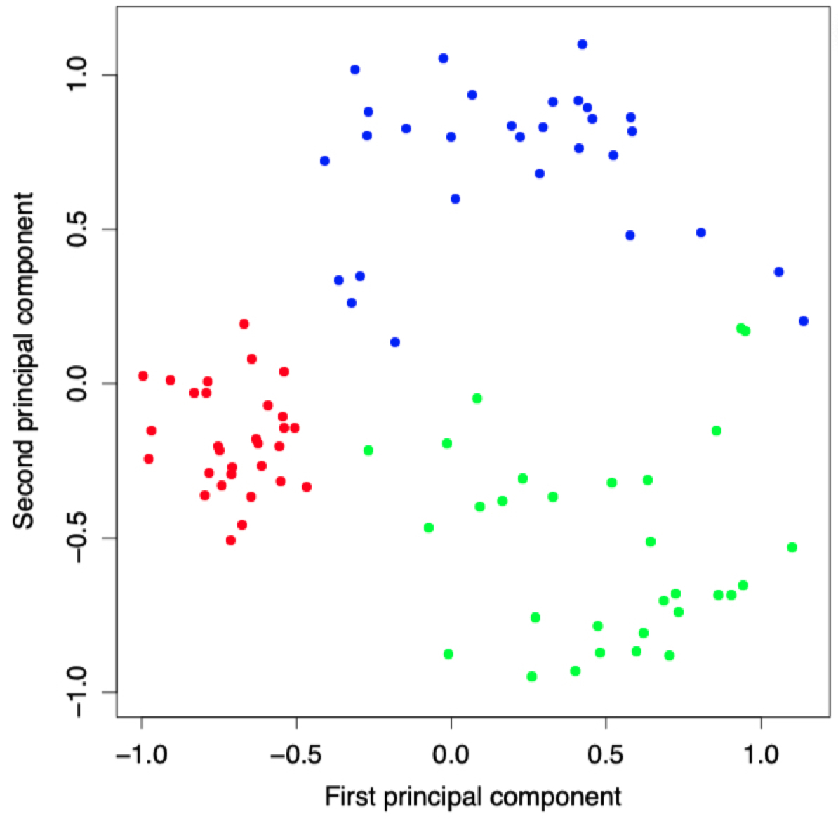
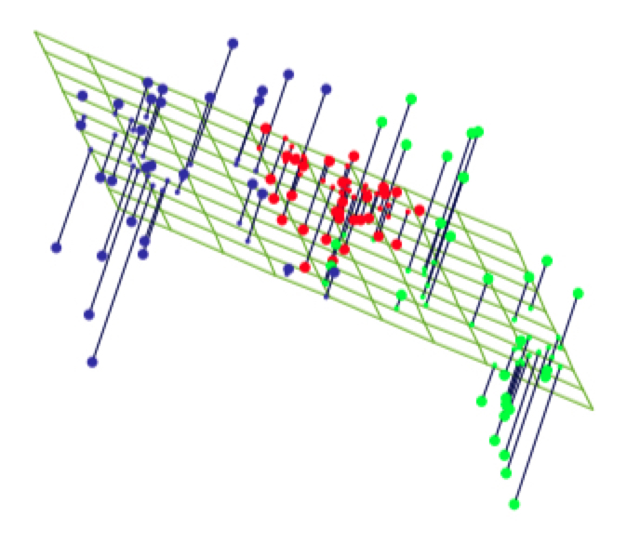
Principal Component Analysis (PCA)
Principal Components (PC) are orthogonal directions that capture most of the variance in the data.
PC 2
PC 1

Slide 26
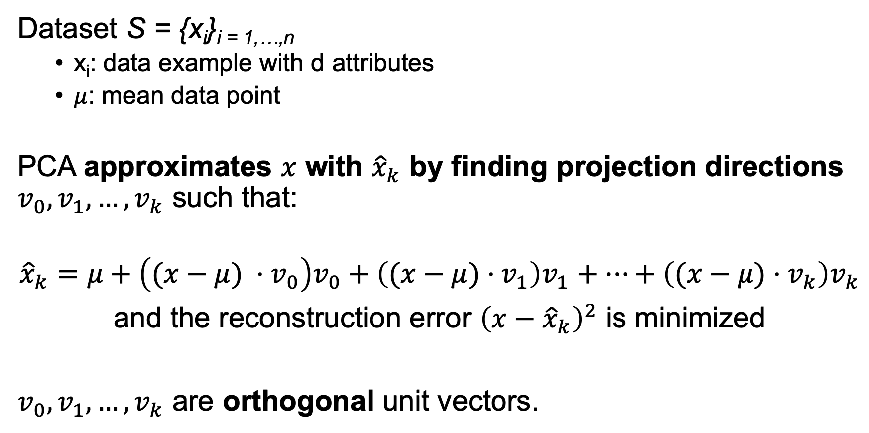
Principal Component Analysis (PCA)
Dataset S = {x_{i}}_{i = 1,…,n}
x_{i}: data example with d attributes
$μ$: mean data point
PCA approximates $x$ with ${\hat{x}}_{k}$ by finding projection directions $v_{0}, v_{1},…, v_{k}$ such that:
$${\hat{x}}_{k}=μ+\left((x−μ) ⋅v_{0}\right)v_{0}+\left((x−μ)⋅v_{1}\right)v_{1}+…+\left((x−μ)⋅v_{k}\right)v_{k}$$
and the reconstruction error ${\left(x−{\hat{x}}_{k}\right)}^{2}$ is minimized
$v_{0}, v_{1},…, v_{k}$ are orthogonal unit vectors.

Slide 27
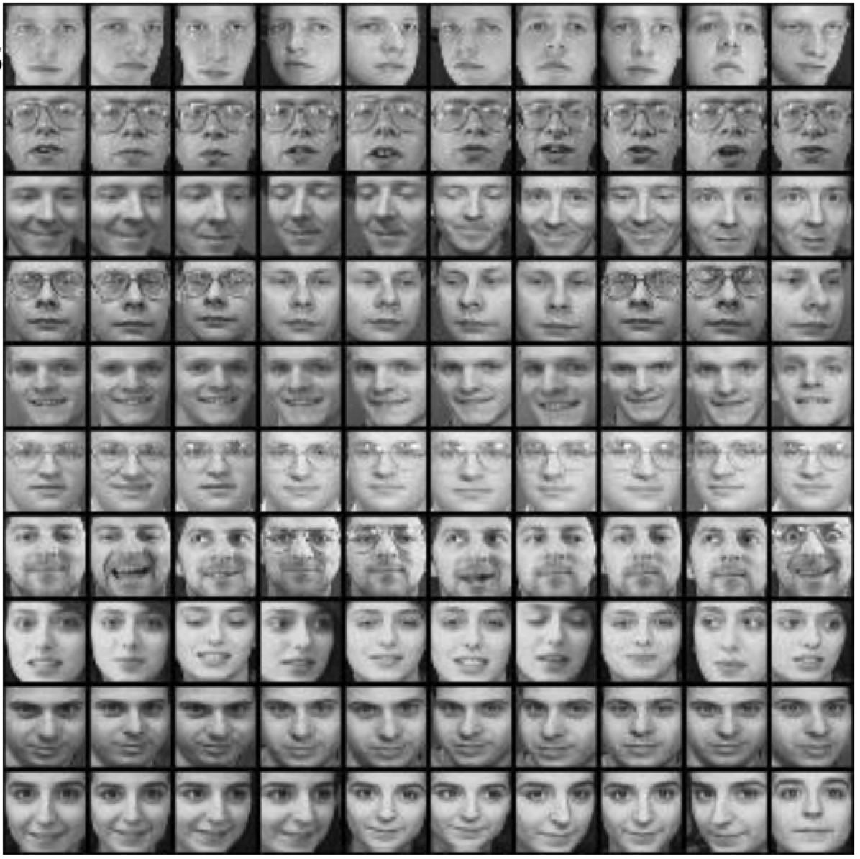
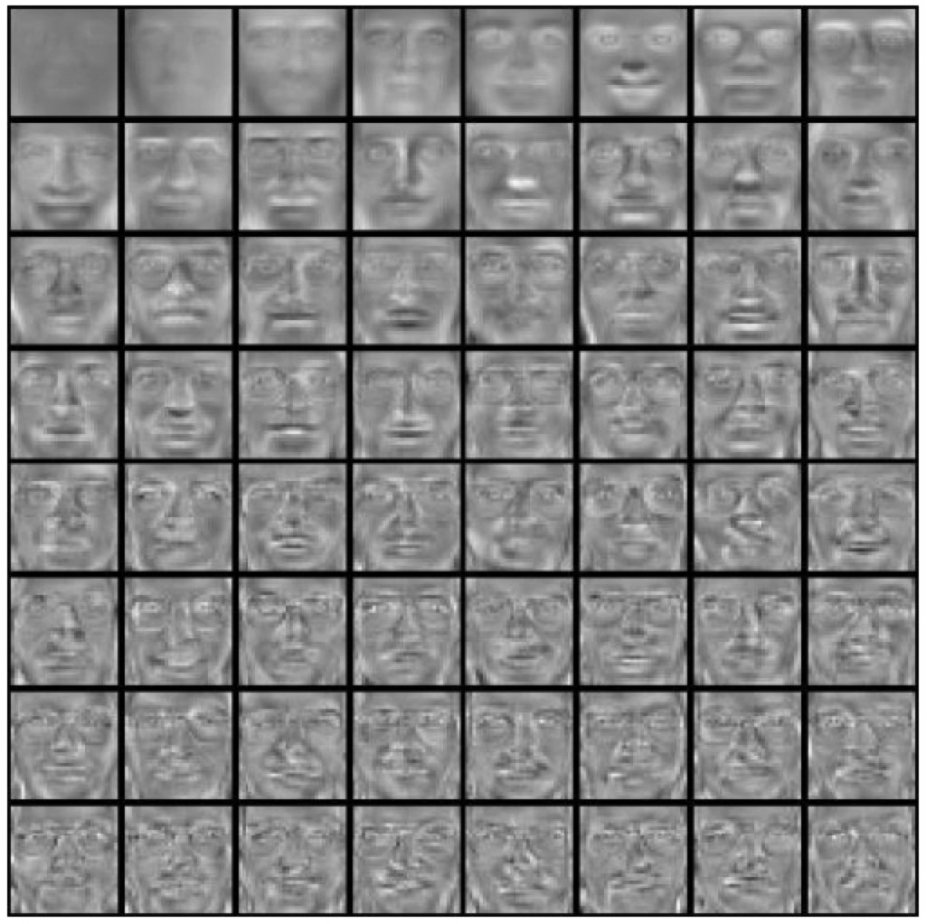
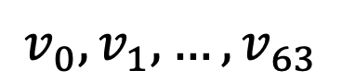
PCA for Face Reconstruction Eigenfaces, slide based on Derek Hoeim’s, UIUC CS543
Image dataset, {x_{i}}_{i = 1,…,n}
64 Principal Components
$$v_{0}, v_{1},…, v_{63}$$
PCA algorithm

Slide 28
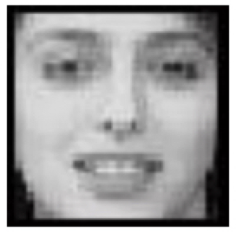
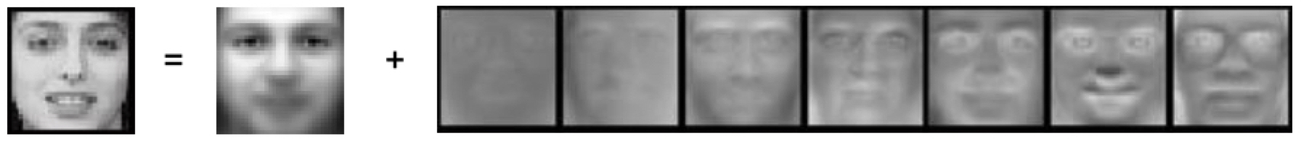

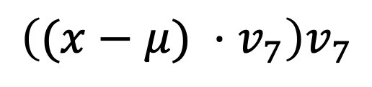
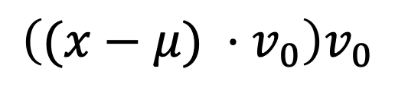
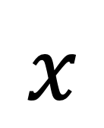
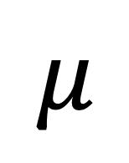
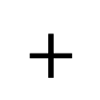
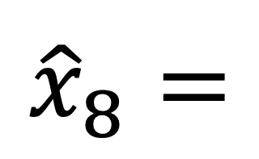
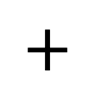
PCA for Face Reconstruction Eigenfaces, slide based on Derek Hoeim’s, UIUC CS543
$$x$$
Face Reconstruction using the Principal Components
$${\hat{x}}_{8}=$$
$$μ$$
$$+$$
$$\left((x−μ) ⋅v_{0}\right)v_{0}$$
$$+$$
$$…$$
$$+$$
$$\left((x−μ) ⋅v_{7}\right)v_{7}$$

Slide 29
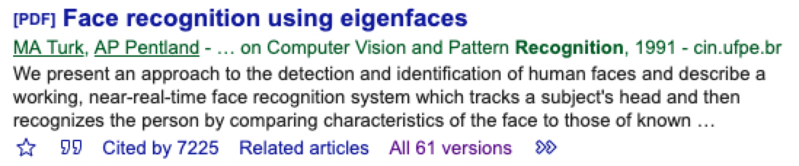
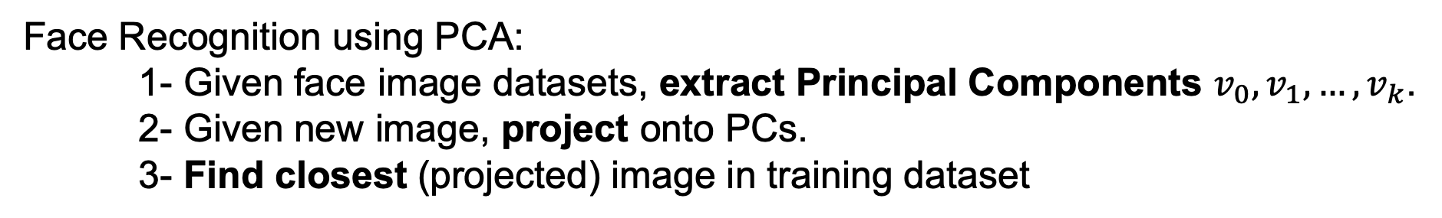
PCA for Face Reconstruction Eigenfaces, slide based on Derek Hoeim’s, UIUC CS543
Face Recognition using PCA:
1- Given face image datasets, extract Principal Components $v_{0}, v_{1},…, v_{k}$.
2- Given new image, project onto PCs.
3- Find closest (projected) image in training dataset
$${\hat{x}}_{8}=$$
$$μ$$
$$+$$
$$\left((x−μ) ⋅v_{0}\right)v_{0}$$
$$+$$
$$…$$
$$+$$
$$\left((x−μ) ⋅v_{7}\right)v_{7}$$
Notes:
https://courses.engr.illinois.edu/cs543/sp2017/lectures/Lecture%2020%20-%20Face%20Recognition%20-%20Vision_Spring2017.pdf

Slide 30
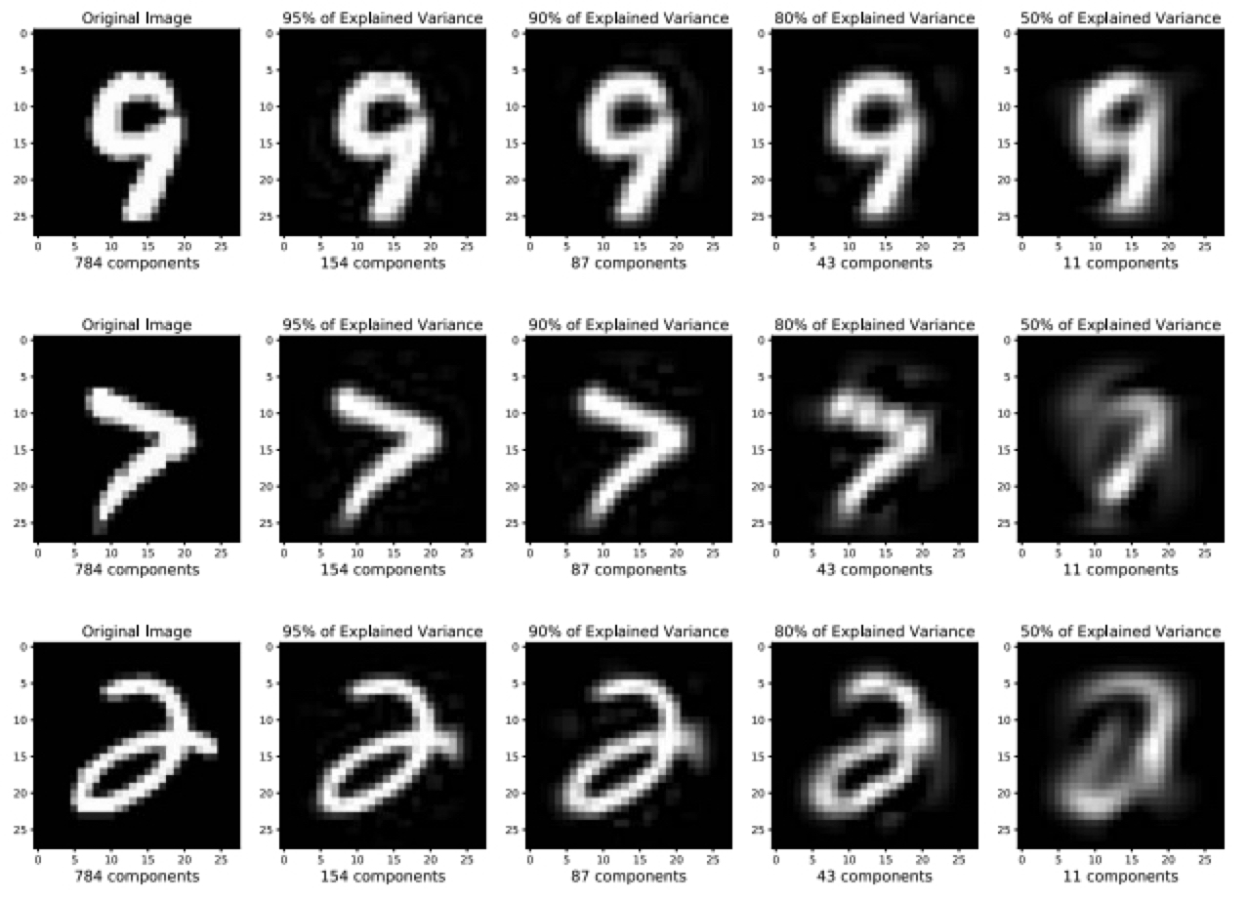
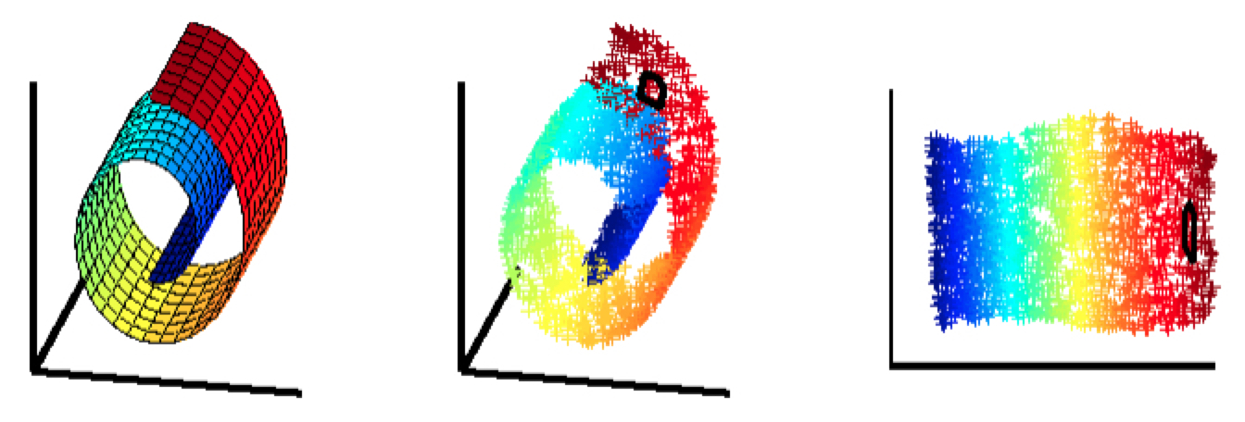
Final words on PCA
Advantages
Fast to compute an optimal solution: an eigenvector problem
No hyper-parameters to tune
Caveats
Limited to second-order dependencies (variance is the limit)
Limited to linear projections
From Michael Guerzhoy’s slides, UofT CSC320

Slide 31
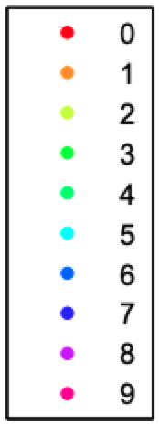
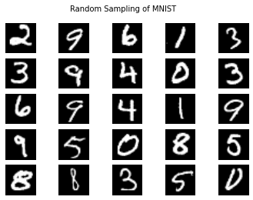
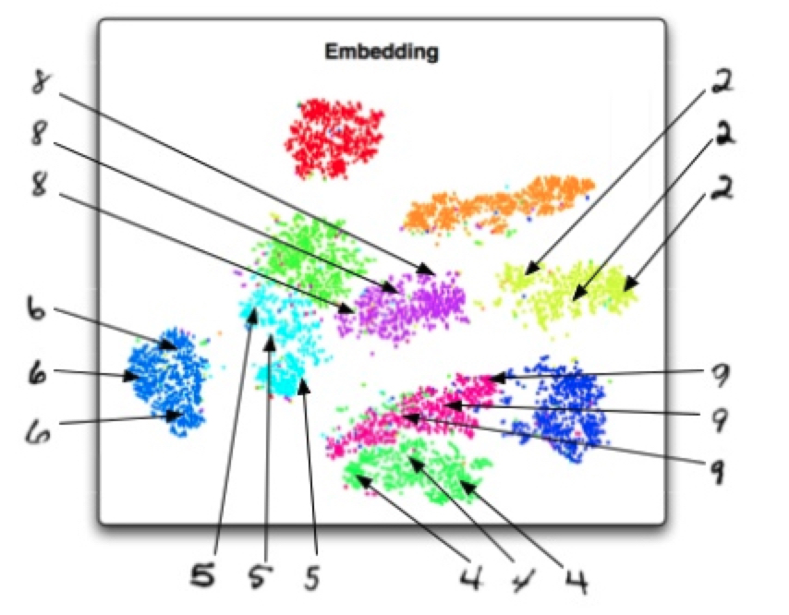
t-SNE t-Distributed Stochastic Neighbor Embedding
784 dimensions = 28x28 pixels
2 dimensions
t-SNE

Slide 32
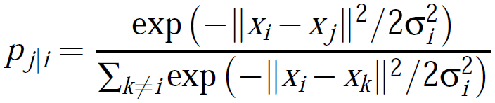
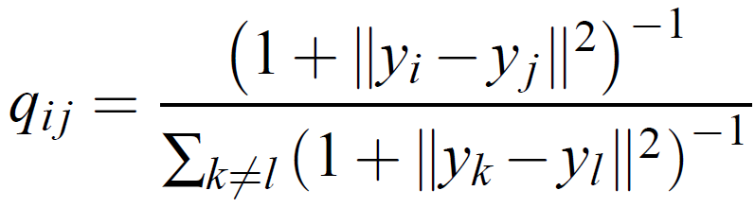
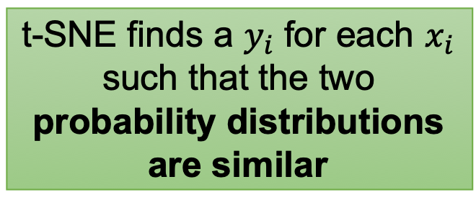
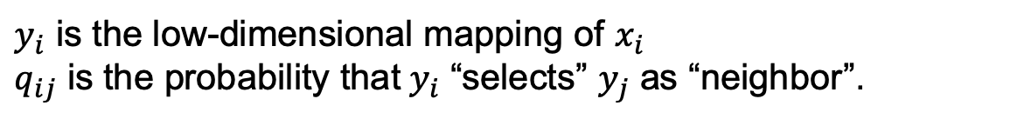
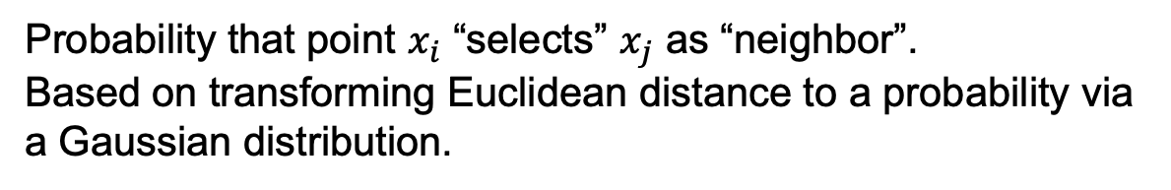
t-SNE t-Distributed Stochastic Neighbor Embedding
high probability
Probability that point $x_{i}$ “selects” $x_{j}$ as “neighbor”.
Based on transforming Euclidean distance to a probability via a Gaussian distribution.
t-SNE finds a $y_{i}$ for each $x_{i}$ such that the two probability distributions are similar
$y_{i}$ is the low-dimensional mapping of $x_{i}$
$q_{ij}$ is the probability that$y_{i}$ “selects” $y_{j}$ as “neighbor”.

Slide 33
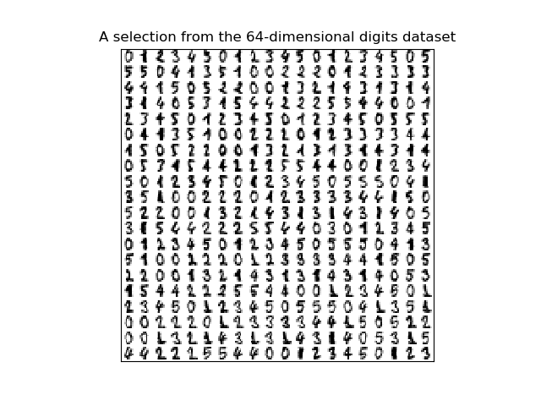
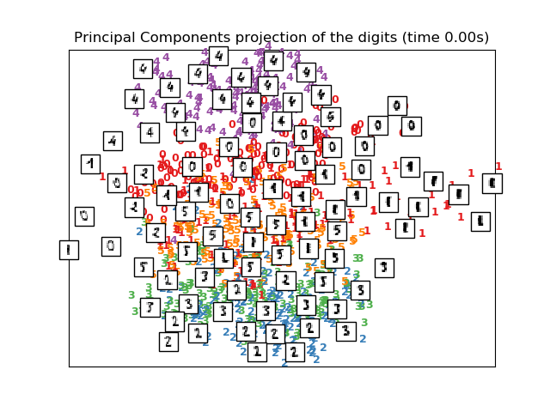
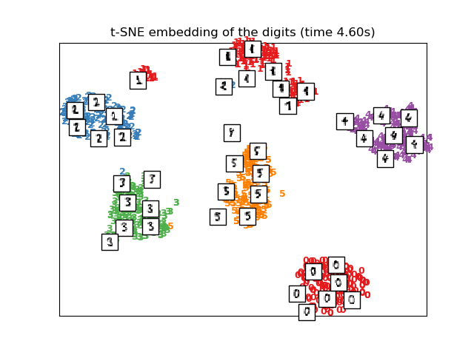
t-SNE t-Distributed Stochastic Neighbor Embedding
PCA
t-SNE
From https://scikit-learn.org/stable/auto_examples/manifold/plot_lle_digits.html

Slide 34
Final words on t-SNE
Advantages
Conserves local and global patterns in the data
Handles highly non-linear data
Caveats
Slow to compute, but PCA preprocessing speeds it up!
Requires careful hyper-parameter tuning
Cannot project a new point
Visualizing the spatial gene expression organization in the brain through non-linear similarity embeddings. Mahfouz et al. (2015)

Slide 35
Interactive dimensionality reduction
https://projector.tensorflow.org/
You can use the “LOAD” button to upload your own data and interactively visualize the results of PCA or t-SNE, in the browser
https://distill.pub/2016/misread-tsne/
t-SNE has some tricky hyper-parameters that must be tuned to the dataset you care about. This interactive study looks at how the hyper-parameters behave and gives guidelines for tuning them to get the best outcomes

